Slide 1
Lab 1
Characterizing the Atmosphere
By Daksh Khandelwal

Slide 2
Objective and Experiment
To determine the accuracy and precision of smartphone pressure sensors using Phyphox, and determine the relationship between atmospheric pressure and altitude
We collected our data in the stairwell of Planetary Hall by placing our phones on the floor on each level
We all used iPhones with Bosch barometers with a sample rate of 1 Hz

Slide 3
Sensor Characterization
The accuracy and precision of the barometers were measured by leaving them on the table inside.
This will help us determine the accuracy and precision of the barometer

Slide 4
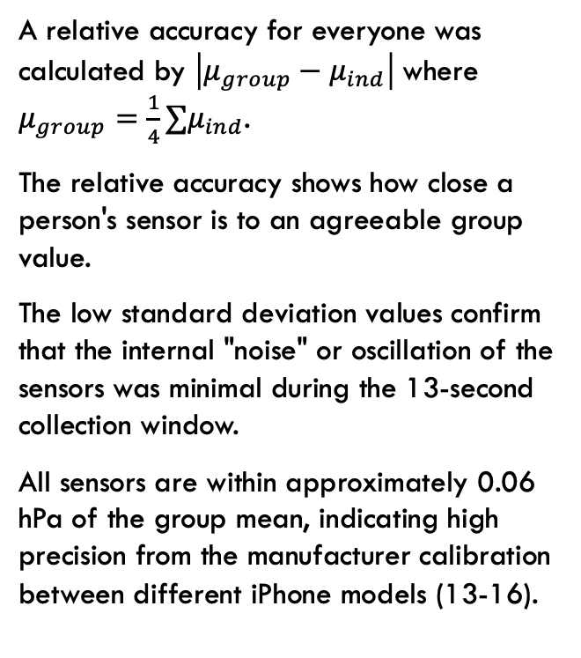
Sensor Characterization
Member | Mean Pressure (hPa) | Standard Deviation (hPa) | Relative Accuracy (hPa)
Daksh | 1012.281 | 0.0017 | 0.058
Clarisse | 1012.285 | 0.004 | 0.062
Tim | 1012.277 | 0.007 | 0.054
Joel | 1012.281 | 0.0017 | 0.058
A relative accuracy for everyone was calculated by $\left|μ_{group}−μ_{ind}\right|$where $μ_{group}=\frac{1}{4}∑μ_{ind}$.
The relative accuracy shows how close a person's sensor is to an agreeable group value.
The low standard deviation values confirm that the internal "noise" or oscillation of the sensors was minimal during the 13-second collection window.
All sensors are within approximately 0.06 hPa of the group mean, indicating high precision from the manufacturer calibration between different iPhone models (13-16).

Slide 5
Sensor characterization
Device Comparison | Calculated Difference (hPa) | Reported Precision (hPa)
Daksh vs. Clarisse | 0.0055 | 0.006
Daksh vs. Tim | 0.0054 | 0.005
Daksh vs. Joel | 0 | 0
Clarisse vs. Tim | 0.0104 | 0.01
Clarisse vs. Joel | 0.0055 | 0.006
Tim vs. Joel | 0.0054 | 0.005
The table here is showing the precision of the sensors by taking the absolute difference of the standard deviations of each person compared to another. The
The reported precision concludes that random fluctuations are negligible

Slide 6
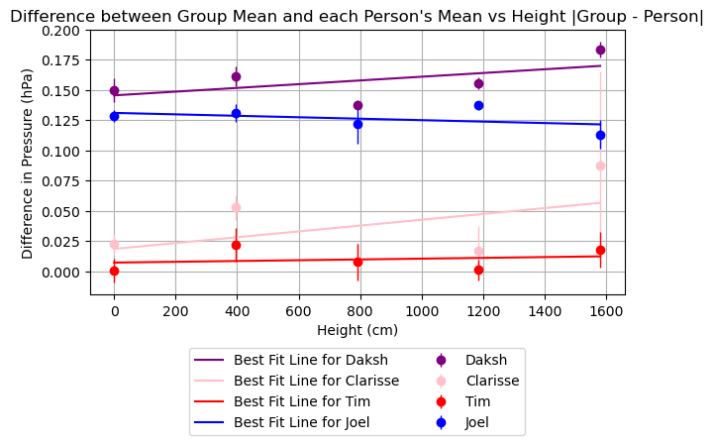
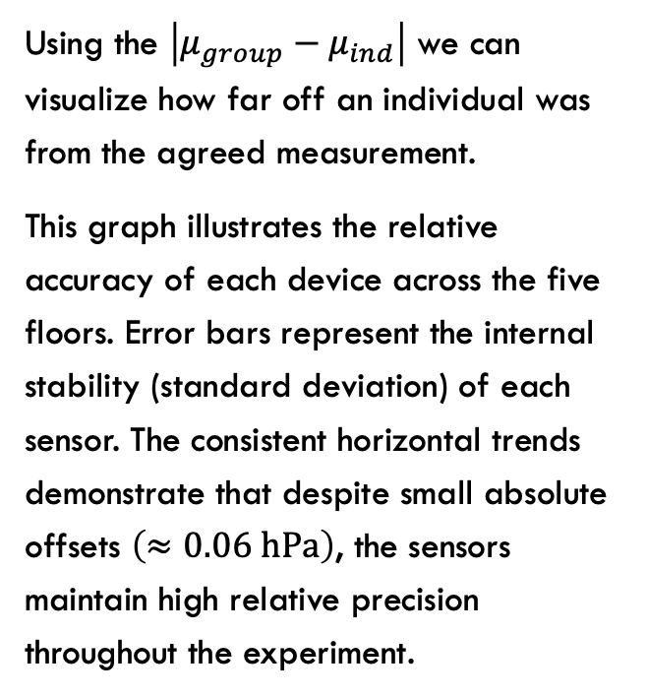
Modeling the relationship between Pressure vs height
Using the $\left|μ_{group}−μ_{ind}\right|$ we can visualize how far off an individual was from the agreed measurement.
This graph illustrates the relative accuracy of each device across the five floors. Error bars represent the internal stability (standard deviation) of each sensor. The consistent horizontal trends demonstrate that despite small absolute offsets $\left(≈0.06 \text{h}\text{P}\text{a}\right)$, the sensors maintain high relative precision throughout the experiment.

Slide 7
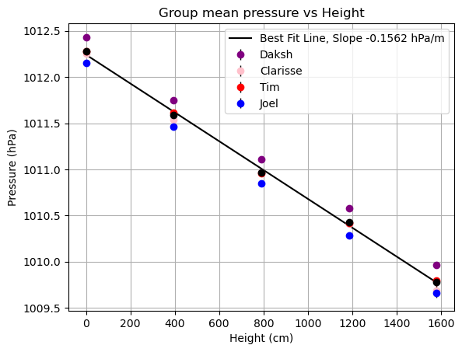
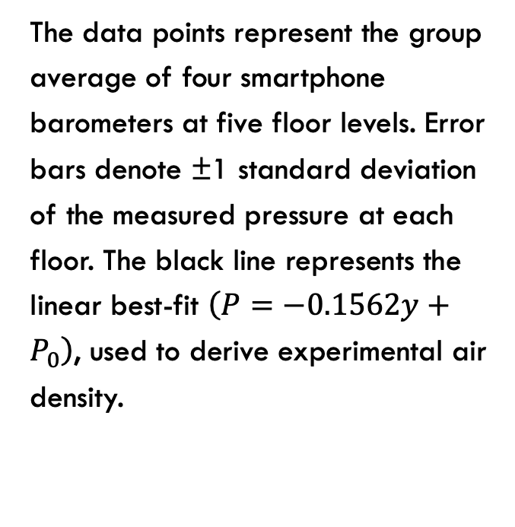
Modeling the relationship between Pressure vs height
The data points represent the group average of four smartphone barometers at five floor levels. Error bars denote ±1 standard deviation of the measured pressure at each floor. The black line represents the linear best-fit $\left(P=−0.1562y+P_{0}\right)$, used to derive experimental air density.

Slide 8
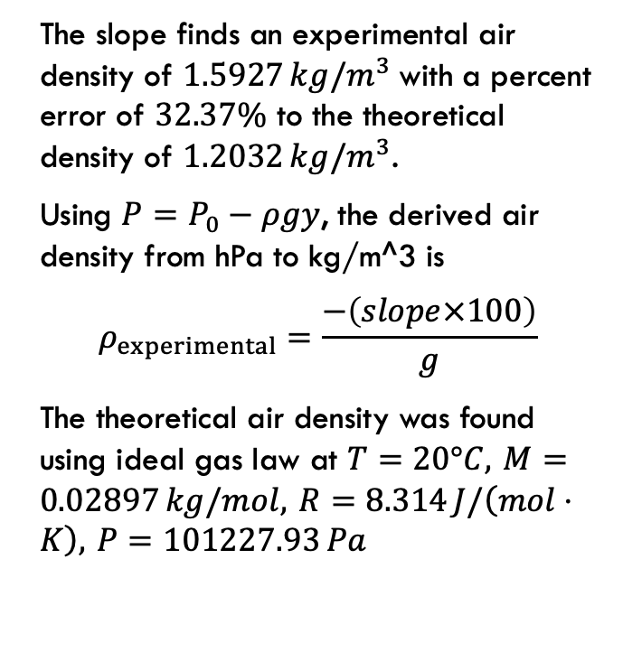
Modeling the relationship between Pressure vs height
The slope finds an experimental air density of $1.5927 kg/m^{3}$ with a percent error of $32.37\%$ to the theoretical density of $1.2032 kg/m^{3}$.
Using $P=P_{0}−ρgy$, the derived air density from hPa to kg/m^3 is
$$ρ_{experimental}=\frac{−\left(slope×100\right)}{g}$$
The theoretical air density was found using ideal gas law at $T=20°C, M=0.02897 kg/mol, R=8.314 J/\left(mol⋅K\right), P=101227.93 Pa$

Slide 9
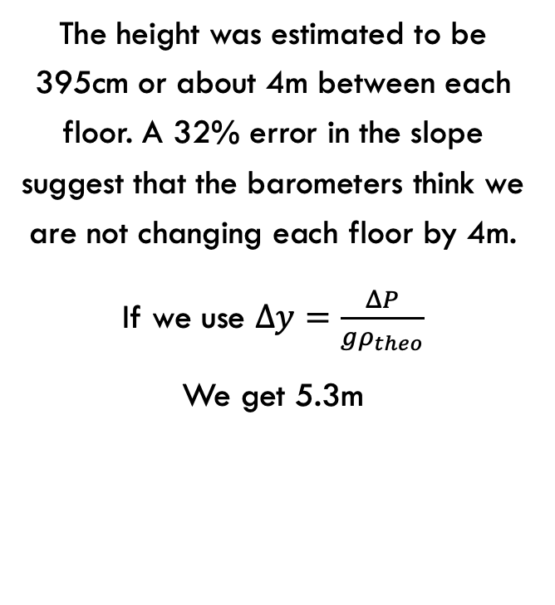
Height discrepancy
Sources of error
  Active ventilation may have caused pressure gradients independent of altitude
The height was estimated to be 395cm or about 4m between each floor. A 32% error in the slope suggest that the barometers think we are not changing each floor by 4m.
If we use $Δy=\frac{ΔP}{gρ_{theo}}$
We get 5.3m

Slide 10
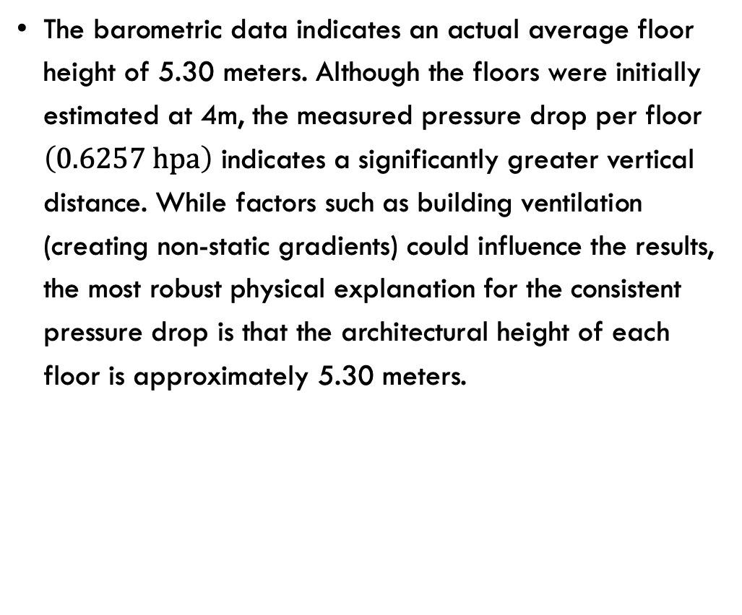
Conclusion
The barometric data indicates an actual average floor height of 5.30 meters. Although the floors were initially estimated at 4m, the measured pressure drop per floor $\left(0.6257 \text{hpa}\right)$ indicates a significantly greater vertical distance. While factors such as building ventilation (creating non-static gradients) could influence the results, the most robust physical explanation for the consistent pressure drop is that the architectural height of each floor is approximately 5.30 meters.
the results are shocking

